Slide 1
Object oriented analysis & design
CS3C015

Slide 2
UNIT- 4
Physical View, Component Diagram, Deployment Diagram, Package, Dependencies on Packages, Modelling System and Subsystems, Patterns and Types of Patterns, Applying Patterns.

Slide 3
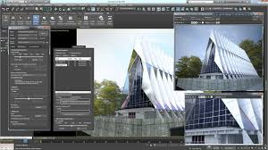
UML- Architecture
Software architecture is all about how a software system is built at its highest level. It is needed to think big from multiple perspectives with quality and design in mind.

Slide 4
UML- Architecture
Software architecture provides a basic design of a complete software system. It defines the elements included in the system, the functions each element has, and how each element relates to one another. In short, it is a big picture or overall structure of the whole system, how everything works together.

Slide 5
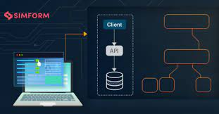

Slide 6
UML- Architecture
To form an architecture, the software architect will take several factors into consideration:
What will the system be used for?
Who will be using the system?
What quality matters to them?
Where will the system run?

Slide 7
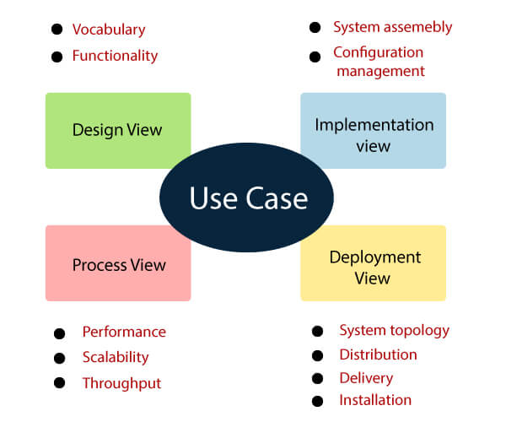
Architecture View Model

Slide 8
Use case view
It is a view that shows the functionality of the system as perceived by external actors.
It reveals the requirements of the system.
With UML, it is easy to capture the static aspects of this view in the use case diagrams, whereas it?s dynamic aspects are captured in interaction diagrams, state chart diagrams, and activity diagrams.

Slide 9
Design View
It is a view that shows how the functionality is designed inside the system in terms of static structure and dynamic behavior.
It captures the vocabulary of the problem space and solution space.
With UML, it represents the static aspects of this view in class and object diagrams, whereas its dynamic aspects are captured in interaction diagrams, state chart diagrams, and activity diagrams.

Slide 10
Implementation View/development view
It is the view that represents the organization of the core components and files.
It primarily addresses the configuration management of the systems releases.
With UML, its static aspects are expressed in component diagrams, and the dynamic aspects are captured in interaction diagrams, state chart diagrams, and activity diagrams.

Slide 11
Process View
It is the view that demonstrates the concurrency of the system.
It incorporates the threads and processes that make concurrent system and synchronized mechanisms.
It primarily addresses the system's scalability, throughput, and performance.
Its static and dynamic aspects are expressed the same way as the design view but focus more on the active classes that represent these threads and processes.

Slide 12
Deployment View/physical view
It is the view that shows the deployment of the system in terms of physical architecture.
It includes the nodes, which form the system hardware topology where the system will be executed.
It primarily addresses the distribution, delivery, and installation of the parts that build the physical system.

Slide 13
Physical view/deployment view
The physical view − It describes the mapping of software onto hardware and reflects its distributed aspect.
The physical view portrays the system from the perspective of a system engineer. The physical layer, it is concerned with the topology of software components as well as the physical connections between these components. The deployment view is another name for this view. The deployment diagram is one of the UML diagrams used to depict the physical perspective.

Slide 14
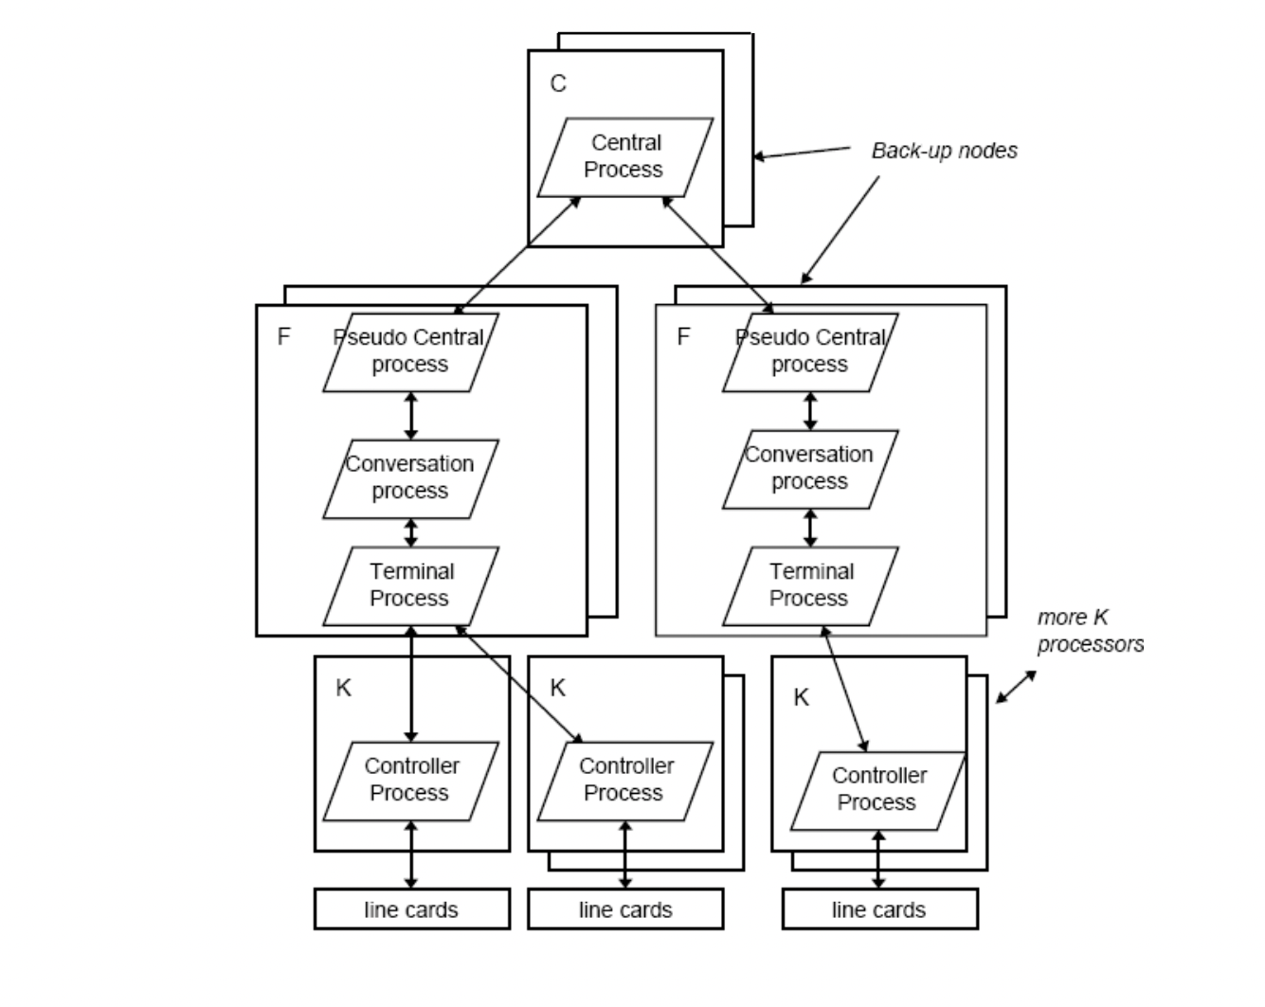
Physical view

Slide 15
4+1 View Model
The 4+1 View Model was designed by Philippe Kruchten to describe the architecture of a software–intensive system based on the use of multiple and concurrent views. It is a multiple view model that addresses different features and concerns of the system. It standardizes the software design documents and makes the design easy to understand by all stakeholders

Slide 16
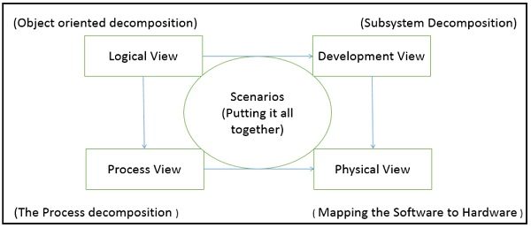
4+1 View Model

Slide 17
 | Logical | Process | Development | Physical | Scenario
Description | Shows the | Shows the | Gives building | Shows the | Shows the
 | component | processes / | block views of | installation, | design is
 | (Object) of | Workflow rules of | system and | configuration | complete by
 | system as well as | system and how | describe static | and deployment | performing
 | their interaction | those processes | organization of | of software | validation and
 |  | communicate, | the system | application | illustration
 |  | focuses on | modules
 |  | dynamic view of
 |  | system

Slide 18
Viewer / Stake holder | End-User, Analysts and Designer | Integrators & developers | Programmer and software project managers | System engineer, operators, system administrators and system installers | All the views of their views and evaluators
Consider | Functional requirements | Non Functional Requirements | Software Module organization (Software management reuse, constraint of tools) | Nonfunctional requirement regarding to underlying hardware | System Consistency and validity
UML – Diagram | Class, State, Object, sequence, Communication Diagram | Activity Diagram | Component, Package diagram | Deployment diagram | Use case diagram

Slide 19
Component diagram
Component diagrams are used in modeling the physical aspects of object-oriented systems that are used for visualizing, specifying, and documenting component-based systems and also for constructing executable systems through forward and reverse engineering.

Slide 20
Purpose of a Component Diagram
The main purpose of the component diagram are enlisted below:
It envisions each component of a system.
It constructs the executable by incorporating forward and reverse engineering.
It depicts the relationships and organization of components.

Slide 21
Why use Component Diagram?
Following are some reasons for the requirement of the component diagram:
It portrays the components of a system at the runtime.
It is helpful in testing a system.
It envisions the links between several connections.

Slide 22
Notation of Component Diagram
A component represents a modular part of a system that encapsulates its contents and whose manifestation is replaceable within its environment.
A Component is a physical piece of a system, such as a compiled object file, piece of source code, shared library or Enterprise Java Bean (EJB).

Slide 23

Notation of Component Diagram
A rectangle with the component's name
A rectangle with the component icon
A rectangle with the stereotype text and/or icon

Slide 24
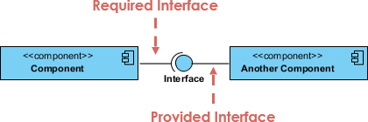
Notation of Component Diagram
2. Interface:- an interface describes a group of operations provided by components.
Provided interface symbols with a complete circle at their end represent an interface that the component provides - this "lollipop" symbol is shorthand for a realization relationship of an interface classifier.

Slide 25
Notations of component Diagram
Required Interface symbols with only a half circle at their end (a.k.a. sockets) represent an interface that the component requires

Slide 26

Notation of Component Diagram
Port:- Ports are represented using a square along the edge of the system or a component. A port is often used to help expose required and provided interfaces of a component.

Slide 27
Notation of Component Diagram
Dependency
A dependency is a relationship that signifies that a single or a set of model elements requires other model elements for their specification or implementation.
This means that the complete semantics of the depending elements is either semantically or structurally dependent on the definition of the supplier element(s).

Slide 28
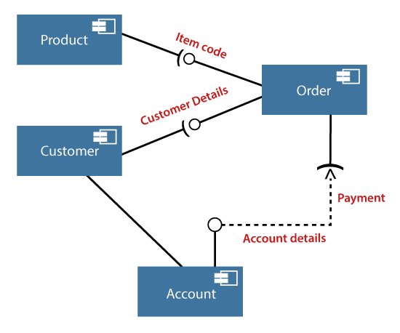
Example of a Component Diagram
A component diagram for an online shopping system is given below:

Slide 29
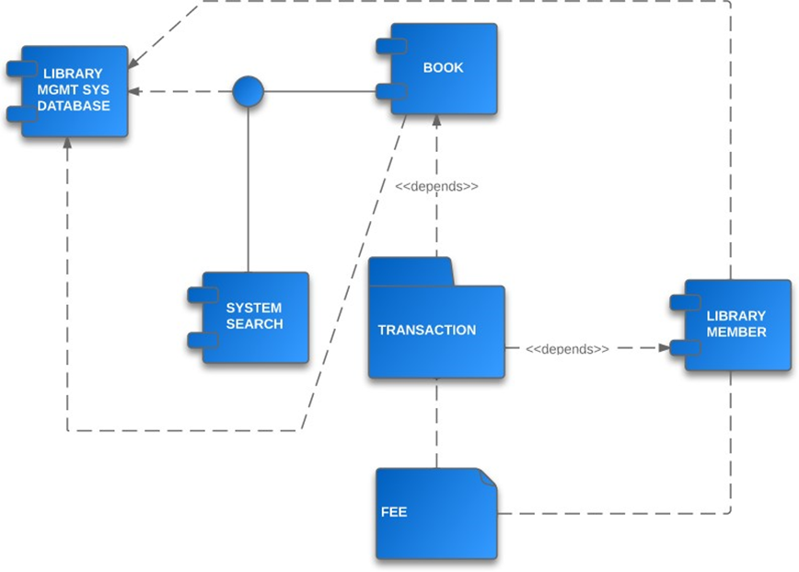

Slide 30
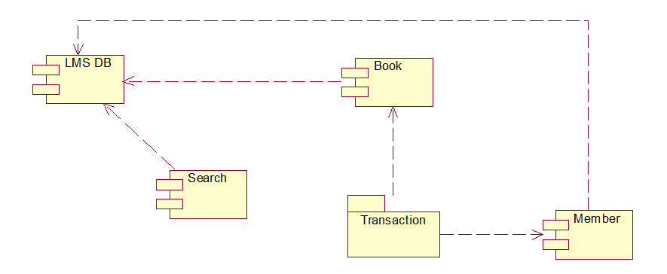
Component diagram for lms

Slide 31
Deployment diagram
The deployment diagram visualizes the physical hardware on which the software will be deployed. It portrays the static deployment view of a system. It involves the nodes and their relationships.
Deployment diagrams are important for visualizing, specifying, and documenting embedded, client/server, and distributed systems and also for managing executable systems through forward and reverse engineering.

Slide 32
Purpose of a deployment Diagram
Following are the purposes of deployment diagram enlisted below:
To envision the hardware topology of the system.
To represent the hardware components on which the software components are installed.
To describe the processing of nodes at the runtime.

Slide 33
Notation of deployment Diagram
Node:- 3-D box represents a node, either software or hardware
1. Device Node:- computing resources that have processing capabilities and the execute programs.
exa:- pc, laptop, mobile phone
2. Execution Environment Node:- is any computer system that resides with in a device node.
Example :- OS,JVM, Servlet.
Link:- communication between two device nodes.

Slide 34
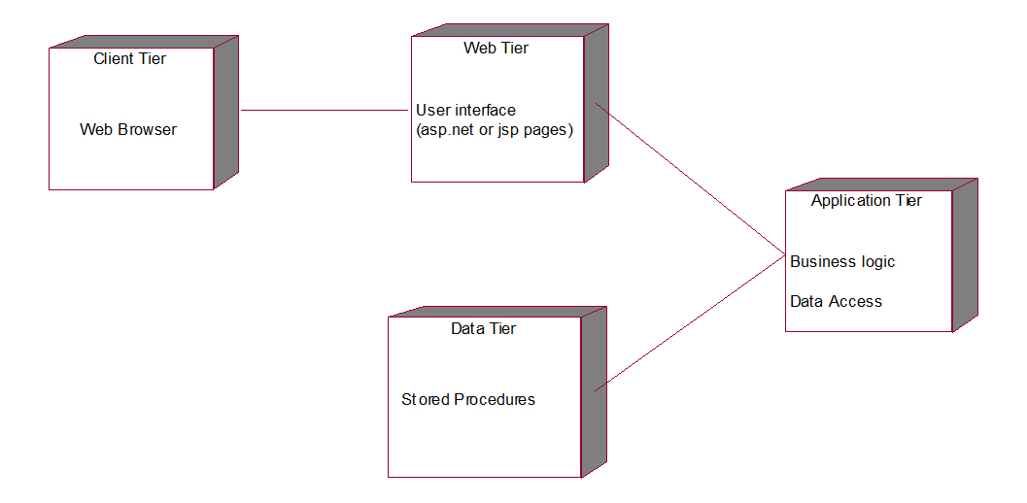
Deployment diagram for lms

Slide 35
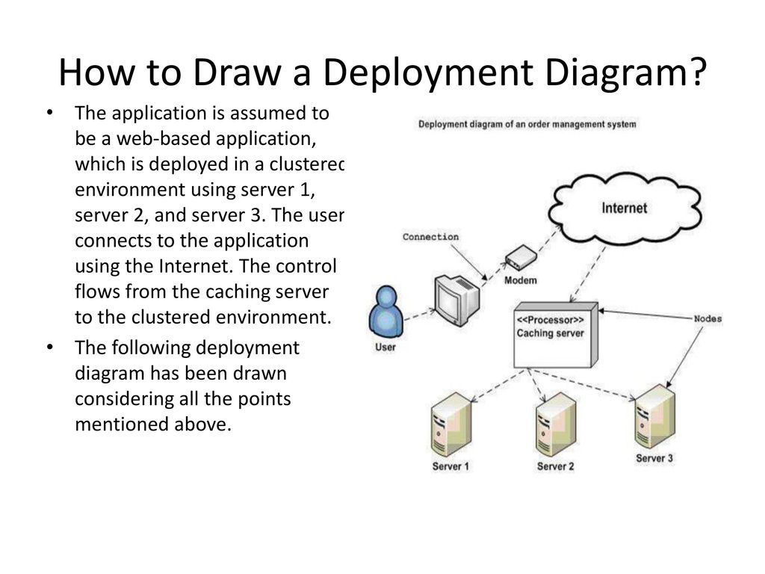

Slide 36
What is a package diagram?
Package diagrams are structural diagrams used to show the organization and arrangement of various model elements in the form of packages. A package is a grouping of related UML elements, such as diagrams, documents, classes, or even other packages. Each element is nested within the package, which is depicted as a file folder within the diagram, then arranged hierarchically within the diagram.

Slide 37
Purpose of package diagram
Package Diagram can be used to simplify complex class diagrams, it can group classes into packages.
A package is a collection of logically related UML elements.
Packages are depicted as file folders and can be used on any of the UML diagrams.
They offer valuable high-level visibility into large-scale projects and systems.

Slide 38
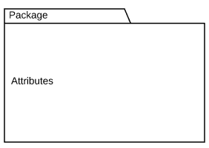

Basic components of a package diagram
The makeup of a package diagram is relatively simple.
Symbol Image | Symbol Name | Description
 | Package | Groups common elements based on data, behavior, or user interaction
 | Dependency | Depicts the relationship between one element (package, named element, etc) and another

Slide 39
notations
Package: A namespace used to group together logically related elements within a system. Each element contained within the package should be a packageable element and have a unique name.

Slide 40
notations
Packageable element: A named element, possibly owned directly by a package. These can include events, components, use cases, and packages themselves. Packageable elements can also be rendered as a rectangle within a package, labeled with the appropriate name.
.

Slide 41
notations
Dependencies: A visual representation of how one element (or set of elements) depends on or influences another. Dependencies are divided into two groups: access and import dependencies

Slide 42
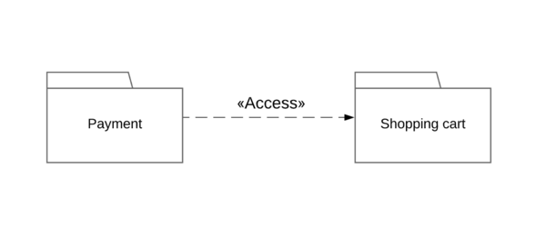
Dependency notations in a package diagram
There are two main types of dependencies:
Access:
<<access>> - one package requires help from functions of other package.

Slide 43
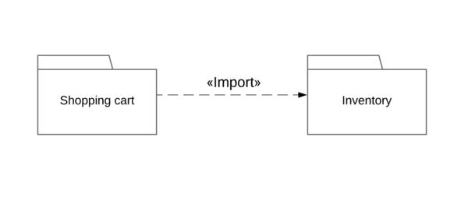
Dependency notations in a package diagram
Import:
<<import>> - one package imports the functionality of other

Slide 44
Dependency notations in a package diagram
Conversely with the example:
X<<access>>Y<<access>>Z
Access is non-transitive.So in the above example,X will not be able to access any of the elements in Z.

Slide 45
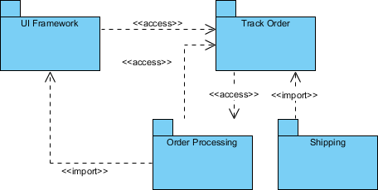
Package diagram example

Slide 46
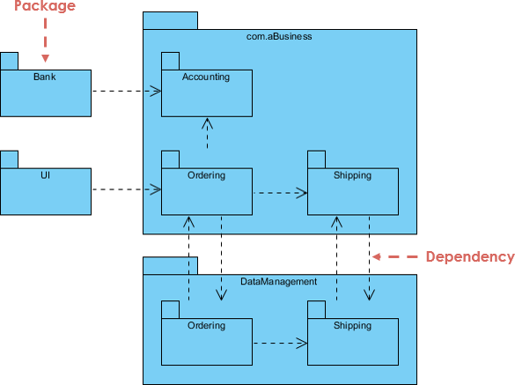

Slide 47
Modelling System and Subsystems

Slide 48
What is Modeling
Modeling consists of building an abstraction of reality.
Abstractions are simplifications because:
They ignore irrelevant details.
They only represent the relevant details.
What is relevant or irrelevant depends on the purpose of the model.

Slide 49
What is Model
A model is a simplification of reality.
A model may provide
blueprints of a system
Organization of the system
Dynamic of the system

Slide 50
Model
A model is an abstraction, before building any system a prototype may be developed. The main purpose of model is for understanding of the system.
Designer build different kinds of models for various purposes before constructing things.
For example car , airplane, blueprints of machine parts, Plan for house construction etc., Models serve many purposes

Slide 51
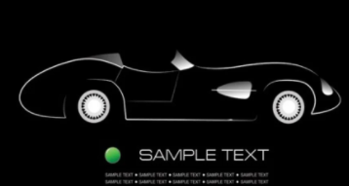
models

Slide 52
Importance of Modeling
Models help us
to visualize a system as it is or as we want it to be.
to specify the structure or behavior of a system.
in providing a template that guides us in constructing a system.
in providing documenting the decisions we have made.

Slide 53
Purpose of Modeling
Designers build many kinds of models for various purposes before constructing things.
Models serve several purposes –
Testing a physical entity before building (simulation)
Communication with customer
Visualization
Reduction of complexity
Better understanding of the problem

Slide 54
Purpose of Modeling
2. Communication with customers
Architects and product designers build models to show their customers. Mock ups are demonstration products that imitate some or all of the external behavior of a system.

Slide 55
Purpose of Modeling
3. Visualization
Storyboards of movies, television shows and advertisements let writers see how their ideas flow. They can modify awkward transitions, and unnecessary segments before detailed writing begins.

Slide 56
Purpose of Modeling
4. Reduction of complexity
The main reason for modeling is to deal with systems that are too complex to understand directly. Models reduce complexity by separating out a small number of important things to deal with at a time

Slide 57
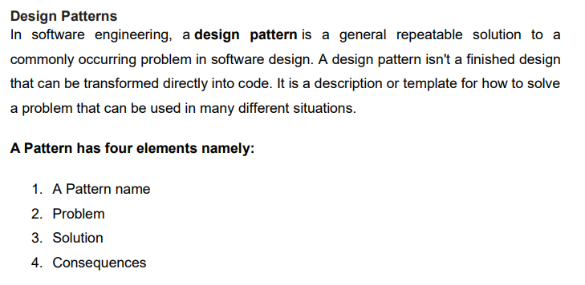

Slide 58
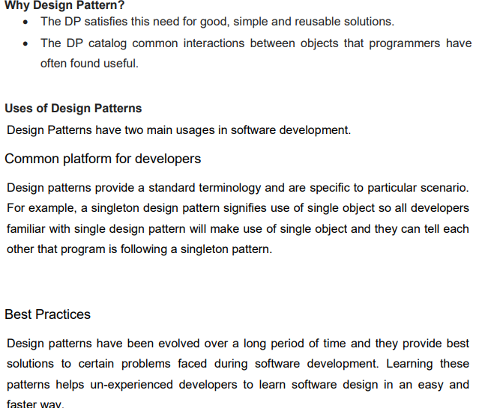

Slide 59
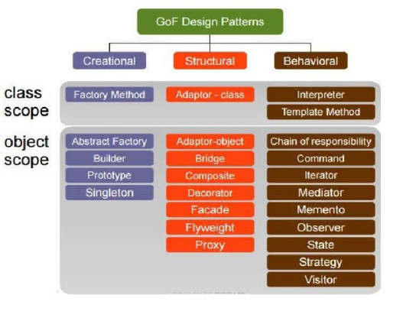
Types of design patterns

Slide 60
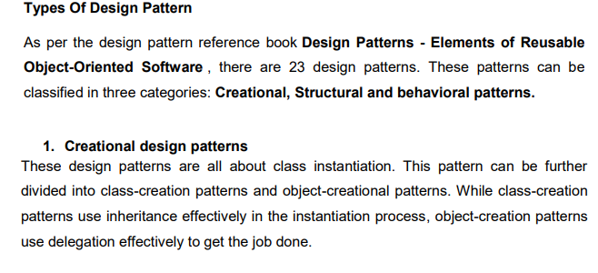

Slide 61
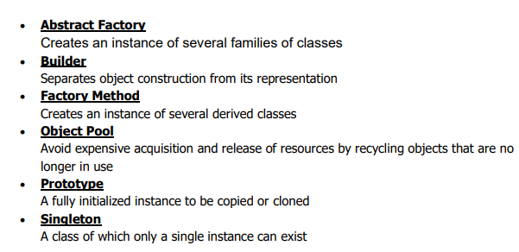
Creational patterns

Slide 62
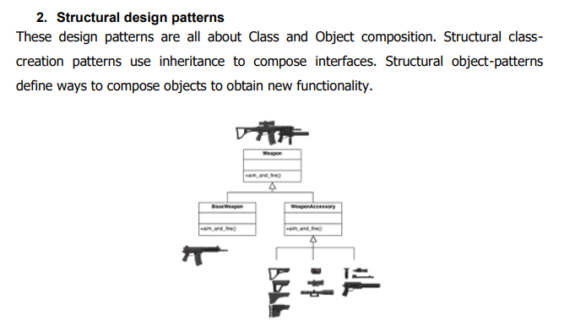

Slide 63
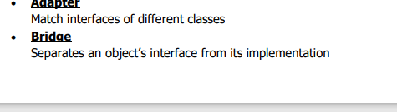
Structural design patterns

Slide 64
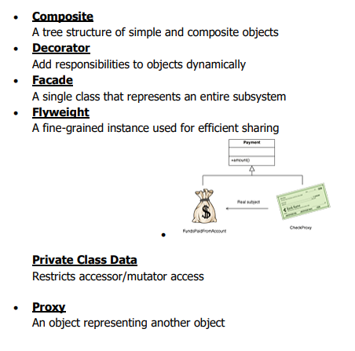
Structural design patterns

Slide 65
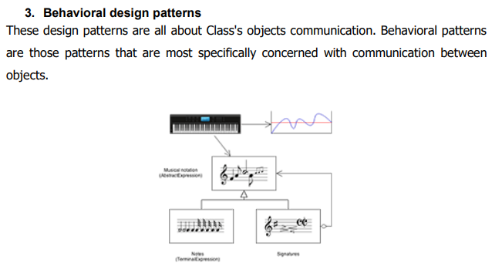

Slide 66
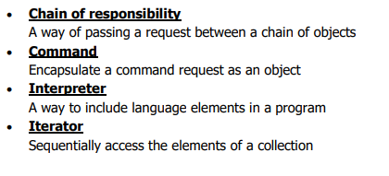
Behavioral design pattern

Slide 67
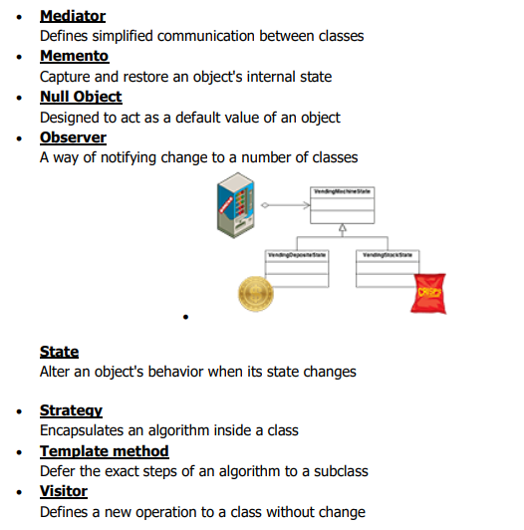
Behavioral design pattern

Slide 68
Decorator Design Pattern
Rick Mercer CSC 335: Object-Oriented Programming and Design

Slide 69
The Decorator Pattern from GoF
Intent
Attach additional responsibilities to an object dynamically. Decorators provide a flexible alternative to sub classing to extend flexibility
Also Known As Wrapper
Motivation
Want to add properties to an existing object.
2 Examples
Add borders or scrollbars to a GUI component
Add stream functionality such as reading a line of input or compressing a file before sending it over the wire

Slide 70
Applicability
Use Decorator
To add responsibilities to individual objects dynamically without affecting other objects
When extending classes is impractical
Sometimes a large number of independent extensions are possible and would produce an explosion of subclasses to support every combination (this inheritance approach is on the next few slides)

Slide 71
An Application
Suppose there is a TextView GUI component and you want to add different kinds of borders and/or scrollbars to it
You can add 3 types of borders
Plain, 3D, Fancy
and 1 or 2 two scrollbars
Horizontal and Vertical
An inheritance solution requires15 classes for one view

Slide 72
That’s a lot of classes!
TextView_Plain
TextView_Fancy
TextView_3D
TextView_Horizontal
TextView_Vertical
TextView_Horizontal_Vertical
TextView_Plain_Horizontal
TextView_Plain_Vertical
TextView_Plain_Horizontal_Vertical
TextView_3D_Horizontal
TextView_3D_Vertical
TextView_3D_Horizontal_Vertical
TextView_Fancy_Horizontal
TextView_Fancy_Vertical
TextView_Fancy_Horizontal_Vertical

Slide 73
Disadvantages
Inheritance solution has an explosion of classes
If another view were added such as StreamedVideoView, double the number of Borders/Scrollbar classes
Solution to this explosion of classes?
Use the Decorator Pattern instead

Slide 74
VisualComponent
draw()
resize()
1
TextView
draw()
resize()
SteamedVideoView
draw()
resize()
Decorator
draw()
resize()
1
Decorator contains a visual component
An imagined example
Border
draw()
resize()
ScrollBar
draw()
resize()
Plain
draw()
resize()
3D
draw()
resize()
Fancy
draw()
resize()
Horiz
draw()
resize()
Vert
draw()
resize()

Slide 75
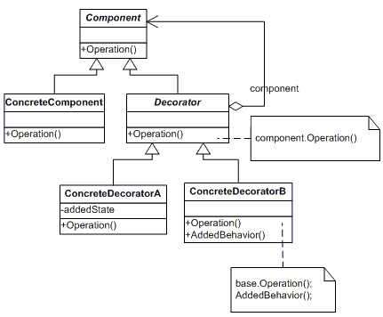
Decorator's General Form

Slide 76
The Observer Design Pattern
Name: Observer
Problem: Need to notify a changing number of objects that something has changed
Solution: Define a one-to-many dependency between objects so that when one object changes state, all its dependents are notified and updated automatically

Slide 77
Examples
From Heads-First: Send a newspaper to all who subscribe
People add and drop subscriptions, when a new version comes out, it goes to all currently described
Spreadsheet
Demo: Draw two charts—two views--with some changing numbers--the model

Slide 78
Examples
File Explorer (or Finders) are registered observers (the view) of the file system (the model).
Demo: Open several finders to view file system and delete a file
Later in Java: We'll have two views of the same model that get an update message whenever the state of the model has changed

Slide 79
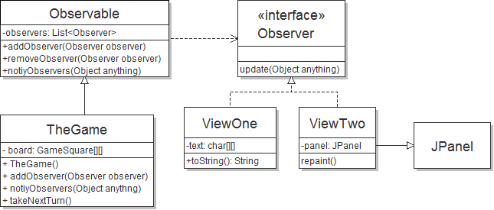
Observer Example

Slide 80
Iterator

Slide 81
Pattern: Iterator
Name: Iterator (a.k.a Enumeration)
Recurring Problem: How can you loop over all objects in any collection. You don’t want to change client code when the collection changes. Want the same methods
Solution: 1) Have each class implement an interface, and 2) Have an interface that works with all collections
Consequences: Can change collection class details without changing code to traverse the collection

Slide 82
GoF Version of Iterator page 257
ListIterator
First()
Next()
IsDone()
CurrentItem()
// A C++ Implementation
ListIterator<Employee> itr = list.iterator();
for(itr.First(); !itr.IsDone(); itr.Next()) {
cout << itr.CurrentItem().toString();

Slide 83
Java version of Iterator
interface Iterator
boolean hasNext()
Returns true if the iteration has more elements.
Object next()
Returns the next element in the iteration and updates the iteration to refer to the next (or have hasNext() return false)
void remove()
Removes the most recently visited element

Slide 84
Java’s Iterator interface
// The Client code
List<BankAccount> bank =
new ArrayList<BankAccount>();
bank.add(new BankAccount("One", 0.01) );
// ...
bank.add(new BankAccount("Nine thousand", 9000.00));
String ID = "Two";
Iterator<BankAccount> itr = bank.iterator();
while(itr.hasNext()) {
if(itr.next().getID().equals(searchAcct.getID()))
System.out.println("Found " + ref.getID());
}

Slide 85
UML Diagram of Java's Iterator with a few Collections
<<interface>>
List
iterator(): Iterator
…
<<interface>>
Iterator
hasNext()
next()
Vector
iterator()
LinkedList
iterator()
ArrayList
iterator()
Iterator
hasNext()
next()
Client
http://download.oracle.com/javase/6/docs/api/java/util/List.html

Slide 86
Thank you

